Slide 1
Overview of Design Patterns
&
The MVC Design Pattern
Sapana Mehta

Slide 2
Design Patterns
A pattern is a proven solution to a problem in a context.
Christopher Alexander says each pattern is a three-part rule which expresses a relation between a certain context, a problem, and a solution.
Design patterns represent a solutions to problems that arise when developing software within a particular context.
i.e Patterns = problems.solution pairs in a context

Slide 3
Background
Started in 1987 by Ward Cunningham and Ken Beck who were working with Smalltalk and designing GUIs.
Popularized by Gamma, Helm, Johnson and Vlissides (The gang of four, Go4)
The three of Go4 were working on frameworks (E++,Unidraw, HotDraw)
Design pattern use a consistent documentation approach
Design pattern are granular and applied at different levels such as frameworks, subsystems and sub-subsystems
Design patterns are often organized as creational, structural or behavioral

Slide 4
Categorizing Pattern
Patterns, then, represent expert solutions to
recurring problems in a context and thus have
been captured at many levels of abstraction
and in numerous domains. Numerous
categories are:
Design
Architectural
Analysis
Creational
Structural
Behavioral

Slide 5
Sun’s J2EE Framework
Components Containers and Connectors: Hiding Complexity, Enhancing Portability
Components are the key focus of application developers
Containers intercede between clients and components, providing services transparently to both, including transaction support and resource pooling.
Connectors sit beneath the J2EE platform, defining a portable service API to plug into existing enterprise vendor offerings.

Slide 6
J2EE
Components
  Enterprise Java Beans (EJB)
  Java Server Pages (JSP)
  Servlets
Containers (service providers)
  Web container
  Bean Container
Connectors (connection service providers)

Slide 7
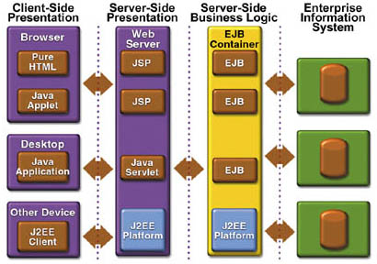

Slide 8
J2EE and Design Patterns
J2EE: AN OPERATING SYSTEM FOR THE WEB Enterprise web applications, which live on networks and are accessible through browsers, are redefining Enterprise Web Software. This is the next wave of computing.
The J2EE architecture is built to enable component developers to use a Model View Controller (MVC) Design Pattern.

Slide 9
Details of MVC Design Pattern
Name (essence of the pattern)
  Model View Controller MVC
Context (where does this problem occur)
  MVC is an architectural pattern that is used when developing interactive application such as a shopping cart on the Internet.
Problem (definition of the reoccurring difficulty)
  User interfaces change often, especially on the internet where look-and-feel is a competitive issue. Also, the same information is presented in different ways. The core business logic and data is stable.

Slide 10
MVC continued
Solution (how do you solve the problem)
  Use the software engineering principle of “separation of concerns” to divide the application into three areas:
    Model encapsulates the core data and functionality
    View encapsulates the presentation of the data there can be many views of the common data
    Controller accepts input from the user and makes request from the model for the data to produce a new view.

Slide 11
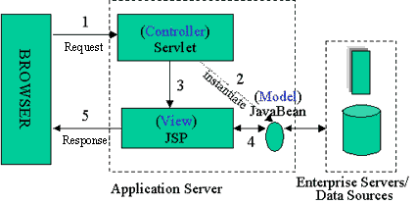
MVC Structure for J2EE

Slide 12
MVC Architecture
The Model represents the structure of the data in the application, as well as application-specific operations on those data.
A View (of which there may be many) presents data in some form to a user, in the context of some application function.
A Controller translates user actions (mouse motions, keystrokes, words spoken, etc.) and user input into application function calls on the model, and selects the appropriate View based on user preferences and Model state.

Slide 13
Example of MVC Design Pattern
Let’s investigate this statement by looking at a small application that demonstrates MVC on J2EE

Slide 14
Java Pet Store- MVC Design Pattern
  The Java Pet Store is a reference application that demonstrates J2EE technologies.
  It demonstrates interaction between Java Server Pages (JSP's), custom Tag Libraries, JavaBeans, and Enterprise Java Beans.
  It demonstrates a real-world approach to application development, where the presentation of data is separated from the process of obtaining data from objects which interact with the enterprise or database tier.
  The Pet Store application implements MVC (Model-View-Controller) design, and demonstrates one way to design an application that should scale well.

Slide 15
Multi Tier Architecture
The Java Pet Store design is divided into multiple tiers:
A. Client tier
B. Web tier
C. Enterprise JavaBeans tier
D. Enterprise Information System tier.
These tiers are not necessarily arranged hierarchically.
Each tier may communicate directly with other tiers, or indirectly by way of intermediate tiers.

Slide 16
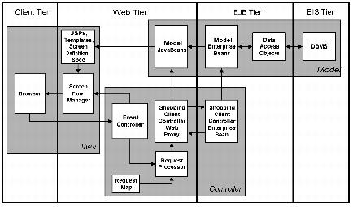
J2EE Architecture Tiers

Slide 17
A. Details of Client Tier
The Client tier is responsible for presenting data to the user, interacting with the user, and communicating with the other tiers of the application.
The Client tier is the only part the application the user ever sees.
The Client tier communicates with other tiers by way of well-defined interfaces.
A separate Client tier in the design provides flexibility and extensibility.

Slide 18
A. Details of Client Tier
In The Java Pet Store Client tier consists mainly of a browser displaying Web pages generated from server-side JSP pages in the Web tier.
Future new clients can be written using technologies or languages that do not yet even exist, since they must conform only to the interface for communicating with other tiers

Slide 19
B. Web Tier
The Web tier is responsible for performing all Web-related processing, such as serving HTML, instantiating Web page templates, and formatting JSP pages for display by browsers.
The Web tier in the Java Pet Store does all of these, and takes on the Controller functions for the Web application, caching model data interpreting user inputs, selecting appropriate Views based on application flow, and managing database connections.

Slide 20
C. EJB Tier
Enterprise JavaBeans are software business components which extend servers to perform application-specific functionality.
The interface between these components and their containers is defined in the EJBs specification.
Essentially, the EJBs tier provides a component model for access to distributed system services and persistent data.

Slide 21
C. EJB Tier
Both stand-alone clients and Web applications in the Web tier can use EJB components hosted by the EJBs tier.
It also simplifies application component development, because details about system issues such as persistence, reentrancy, transactions, remote access, and so on, are all handled by the container.

Slide 22
D.Enterprise Information System (EIS) Tier
The EIS tier is the enterprise information infrastructure.
Members of the EIS tier typically include enterprise information planning (ERP) systems, transaction processing monitors, relational database management systems, and legacy enterprise applications.
Access to the EIS tier is usually transactional, to ensure that data are consistent across application boundaries.
The EIS tier also enforces security and offers scalability.

Slide 23
MVC supports Modular Design
  Has set of modules, each tightly coupled internally, and loosely coupled between modules.
  Each module has an interface that defines the module's functional requirements and provides a place where third-party products may be integrated.
  The Java Pet Store demo modules are:
    User Account
    Product Catalog
    Order Processing
    Messaging
    Inventory
    Control
  The Modular design supports the design goal of reusable software.

Slide 24
Java Pet store- MVC
Views
  JSP pages, composed with templates and displayed in an HTML browser
Controller
  maps user input from the browser to request events, and forwards those events to the Shopping Client Controller in the EJB tier.
Model
  EJB Tier

Slide 25
MVC Details in Java Pet store
Model represents the structure of the data in the application, as well as application-specific operations on data
- CartModel, InventoryModel, CustomerEJB, and others
Views are Java server pages (JSPs)
  rendered from the web container to the browser, stand-alone applications that provide View functionality, and interfaces to spreadsheet programs, such as the StarOfficeTM suite.
Controller is server side java program (Servlet)
  MainServlet.java, which dispatches browser requests to other controller objects, such as ShoppingClientController.java, AdminClientController.java, and their related support classes.

Slide 26
Views:Java Server Page (JSP)
http://java.sun.com/products/jsp/
Technology for developing dynamic web sites that replaces CGI
Thought of as a server-side scripting tool
Contains HTML and Java code (scripts)
Is compiled into a servlet and executes on the server.

Slide 27
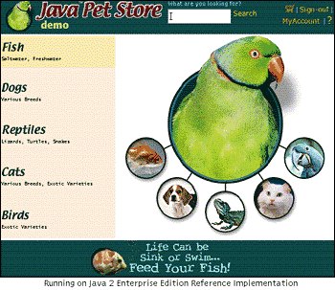
JSP Example

Slide 28
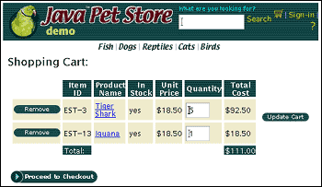

ShoppingCart.jsp
Java Server Pages (JSP)

Slide 29
Controller Servlet
A java class that runs on the server
Extends http Servlet
Runs in a container class
(servlet/JSP engine)
Application servers (Jrun, WebLogic) have the containers
This has the logic for the application

Slide 30
EJBs
Enterprise Java Beans Connect Servlets to the back end database
Examples of EJBs in Java Pet store are:
AccountHandler, ModelUpdateManager, ShoppingClientControllerHome, CartHandler,
ShoppingClientControllerEJB, SigninHandler, OrderHandler

Slide 31
Advantages of MVC
Separating Model from View (that is, separating data representation from presentation)
- easy to add multiple data presentations for
the same data,
-facilitates adding new types of data
presentation as technology develops.
-Model and View components can vary
independently enhancing maintainability,
extensibility, and testability.

Slide 32
Advantages of MVC design Pattern
Separating Controller from View (application behavior from presentation)
- permits run-time selection of appropriate
Views based on workflow, user preferences,
or Model state.
Separating Controller from Model (application behavior from data representation)
- allows configurable mapping of user actions
on the Controller to application functions on
the Model.

Slide 33
Consequences or Benefits
We make changes without bringing down the server.
We leave the core code alone
We can have multiple versions of the same data displayed
We can test our changes in the actual environment.
We have achieved “separation of concerns”

Slide 34
References
Home of the patterns community
  http://hillside.net/
Adaptability home page
  http://www.utdallas.edu/~chung/adaptability.html
Quickest road to understanding the concepts
non-software examples
  http://www.agcs.com/supportv2/techpapers/patterns/papers/tutnotes/index.htm
The Sun location for J2ee
  http://java.sun.com/j2ee/
Sun’s Java Pet store example used
  http://jboss.utdallas.edu:8080/estore

